Slide 1
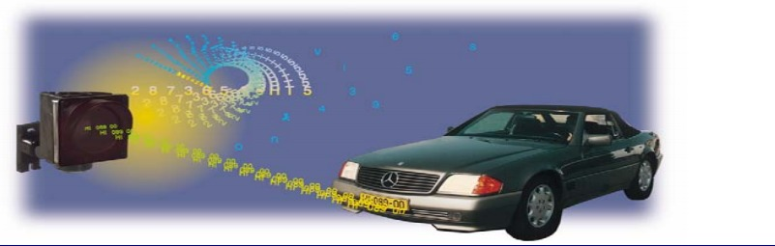
Suspicious Vehicle Tracking (SVT)
Using Intel Distribution for Python

Slide 2
Purpose
Suspicious Vehicle Tracking System is a Computer Vision Application that could be used to identify and track and suspicious vehicle .This system is useful in many fields like theft control, raid on migrant-smuggling vehicles , parking lots.
By enabling smart tracking, suspicious person can be track down with the help of images vehicle involved by effective use of traffic cameras
Currently this process is manual and heavily dependent on human search and presence of mind to understand all routes captured by the traffic cameras

Slide 3
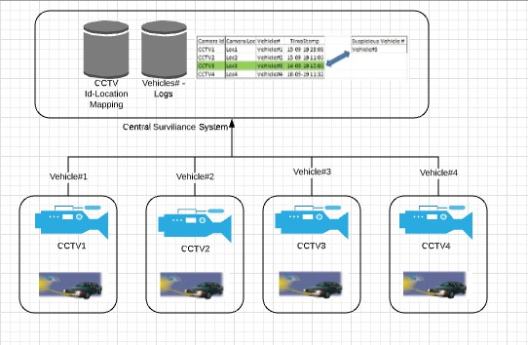
Problem Overview

Slide 4
Discussion
Images containing texture and background objects.
Presence of regular structure called bumper near (above/below) the license plate, which is same dimension as license plate
If the lighting conditions are not fair enough leads to loss of characters from the license plate.
Few car images also consist of brand names, captions and other symbols in addition to license plates, which are difficult cases for segmentation.

Slide 5

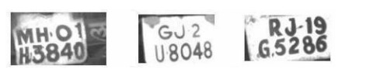
Recognized plates
License plates failed in recognition

Slide 6
Conclusion
SVT system is scalable across various business verticals
Features like character height , spacing , LP height and width are used for LP detection

Slide 7
THANK YOU !!

